Slide 1
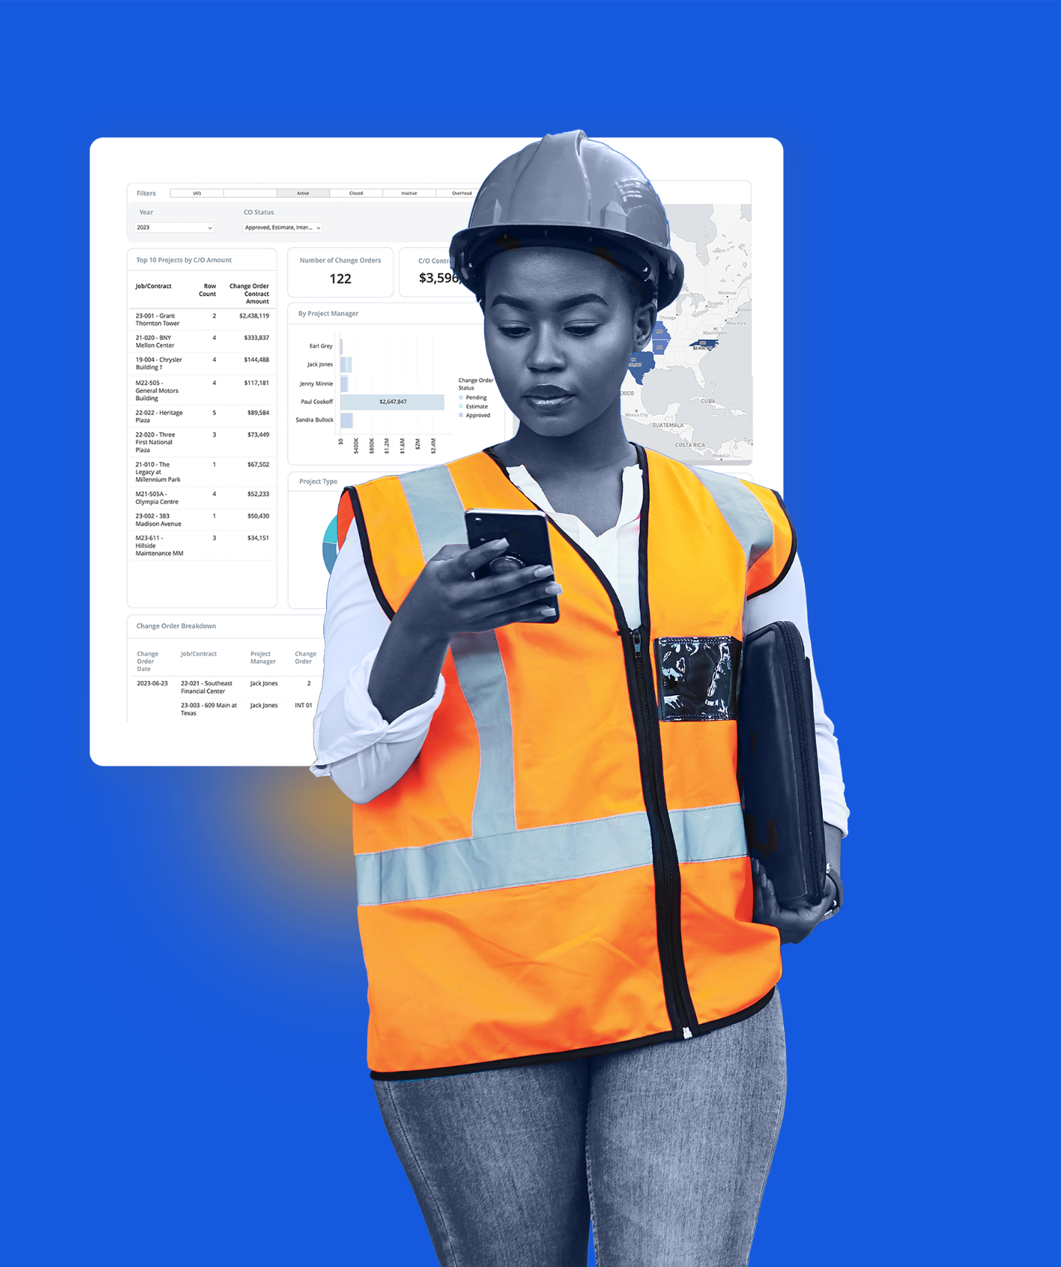
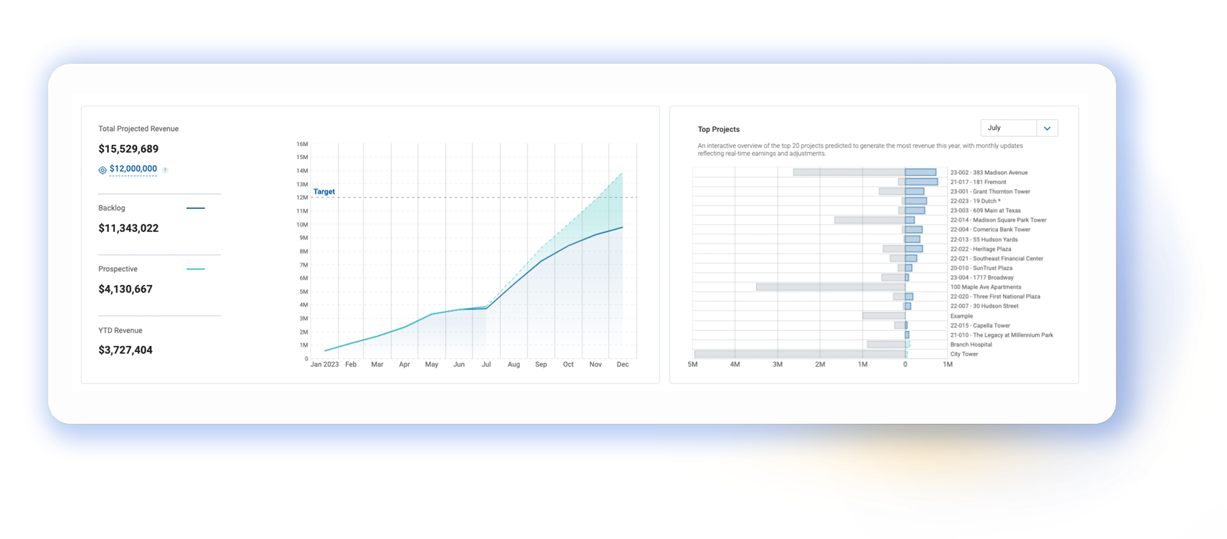
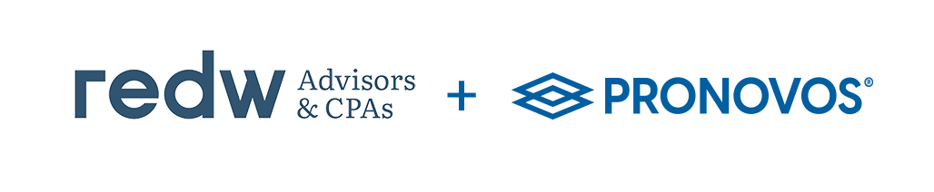
ProNovos: Construction Financial Intelligence Tool
Protect profits, boost cash flow, and improve job outcomes
Notes:
Use this slide deck as a tool to talk to your clients about the Power of ProNovos' Construction Financial Analytics tool. On each slide, we have provided you with talking points and a script; feel free to use whichever is easiest and edit it accordingly to fit your tone and presentation style.
Talking Points:
ProNovos is a premier cloud-based construction financial analytics solution.
Leveraging existing enterprise resource planning (ERP) systems, ProNovos streamlines complex data into user-friendly workflows accompanied by easy-to-read charts and graphs.
This transformation enables contractors to understand their finances better while safeguarding their profits.
Whether through executive dashboards, revenue projections, or cash flow forecasting, ProNovos empowers users to make informed decisions and helps leaders fortify and expand their construction businesses.
ProNovos manages over $10 Billion in Annual Construction Volume and has over 1,500 users.
Who are ProNovos Customers?
A large and diverse portfolio of construction businesses served, from general contractors to all specialty trade types, ranging from sizes of $10 Million up to $1.2 Billion.
They work with:
Executives and financial leaders in the office
Project Managers and all project team members in the field
Script:
Today, I want to introduce you to ProNovos—a cloud-based construction financial analytics solution. It’s a tool to help you and your team make sense of your construction business’s financial data.
Here are two significant ways ProNovos can help you:
Since it is designed to simplify construction financials, it takes your existing ERP and works its magic to streamline complex data into user-friendly workflows. Think of it as a translator for your financial data, turning it into easy-to-read charts and graphs. This transformation is about helping you and your team better understand their finances while safeguarding those hard-earned profits.
ProNovos is also your ally when it comes to making informed decisions. Whether you’re a leader in need of executive dashboards, looking for revenue projections, or cash flow forecasting, ProNovos has you covered. It’s a tool that empowers you to make intelligent choices and helps leaders strengthen and grow their construction businesses.
ProNovos manages over $10 billion in annual construction volume. That’s a testament to its effectiveness. With over 1,500 users, ProNovos has earned the trust of the construction industry. ProNovos’ customers come from a diverse portfolio of construction businesses, ranging from general contractors to specialty trade contractors.
Now, I want to show you some specific ways ProNovos can help; let’s look at how it can protect your profits.

Slide 2
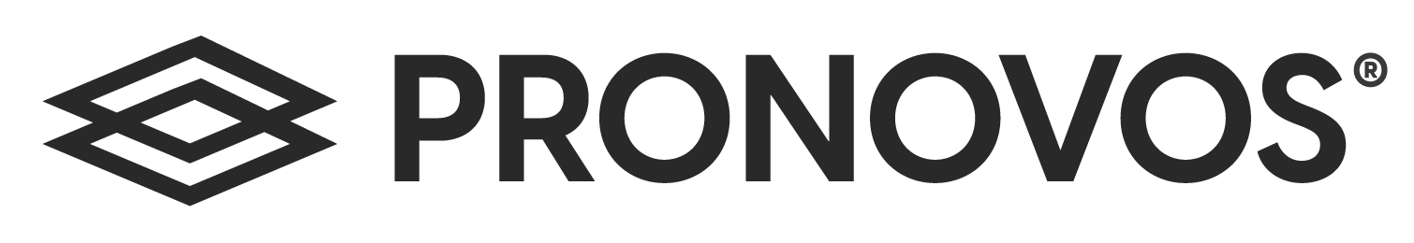
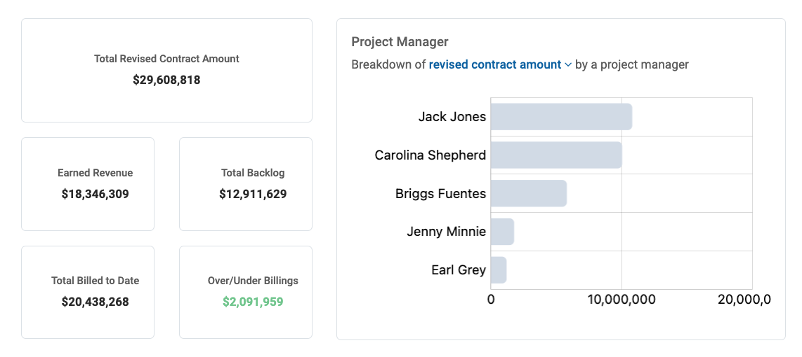
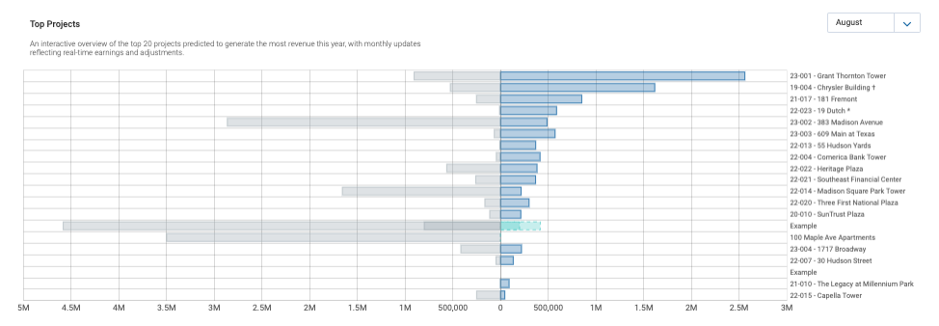
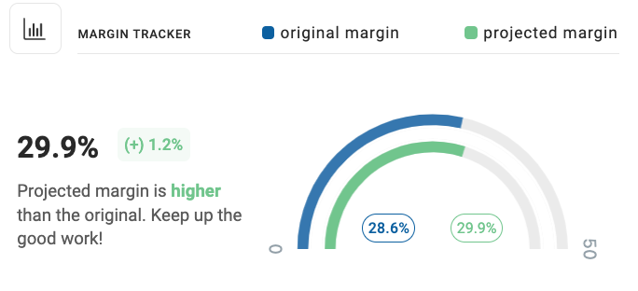
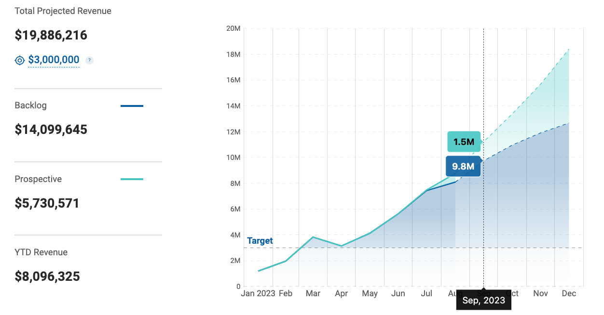
Protect Profits
Automate and streamline WIP schedules
Visualize real-time KPIs, from the executive down to the project level
Forecast job cost more accurately
Monitor revenue forecasts
Notes:
Talking Points:
ProNovos enhances your business by automating key reports, empowering Project Managers, enabling revenue forecasting, and providing clear executive and project-level insight that protects your business’s hard-earned profits. They do this by:
WIP Report Automation
Automate your WIP Report for daily updates
Access over 50 key metrics to include in your WIP, including profit margin, % completion, over & billings, and earned revenue.
Filter through the report by Project Manager, job status, dates, types, profitability, and more.
Drill down into project performance for real-time updates and risk identification.
Export reports to PDF, CSV, or Excel for easy sharing and analysis.
Projected Final Costs (PFC) for Project Managers
Empower Project Managers with essential project financial metrics.
Including the contract amount, an up-to-date revised margin, and job-to-date costs.
The PFC offers seven different adjustment methods, including percentage complete, cost-to-complete, hours to complete, quantity to complete, complete line item, project hours
Capture critical details of all adjustments that include the amount, the root cause, the date, the person making the adjustment, and leave a note for additional context
Providing a detailed breakdown of all transactions for each line item
Revenue Forecasting at the Company & Project Level
At the company level:
Enhance forecasting accuracy with up-to-date backlog and prospective job data
Set revenue targets and track progress month-to-month
Adjust forecasts using different scenarios and standard curves
At the project level (for Project Managers):
Monitor contract amount, earned revenue, backlog, and % completion
Accurately forecast work completed or costs incurred each month
Utilize linear, S-curve, or custom curves for trajectory analysis
Compare projected vs. actual completion percentages easily
Gain a Clear Picture: Executive & Project Overview Dashboards
Executive Dashboard:
Filter through financial reports and monitor critical ratios into liquidity, profitability, leverage, and efficiency
Access quick and accurate information on profitability, AR, AP, payroll, billing status, and change orders
Project Overview Dashboard (for Project Managers):
Provides a comprehensive job cost report overview.
Allows tracking of billing progress, percentage billed, and confirmed
Offers insights into change orders' impact on project contracts, budgets, and margins
Enables monitoring and identification of trends in labor activity
Script:
ProNovos enhances your business by automating key reports, empowering Project Managers, enabling revenue forecasting, and providing clear executive and project-level insight that protects your business’s hard-earned profits. Let’s explore the four areas that will achieve this:
1. WIP Report Automation:
Imagine having your WIP report automatically updated daily. With ProNovos, this becomes a reality. You can access over 50 key metrics to include in your WIP report, such as profit margin, percentage completion, over and billings, and earned revenue. The best part? You can filter this report by criteria like Project Manager, job status, dates, types, and profitability. Plus, you can drill down into project performance for real-time updates and risk identification. It's a breeze when you need to share or analyze this data because you can export reports to PDF, CSV, or Excel.
2. Projected Final Costs (PFC) for Project Managers:
For Project Managers, ProNovos is a game-changer. It empowers them with essential project financial metrics, including the contract amount, an up-to-date revised margin, and job-to-date costs. But that's not all; ProNovos offers seven different adjustment methods, allowing for project management flexibility. You can capture critical details of all adjustments, including the amount, the root cause, the date, the person adjusting, and leave a note for additional context. It provides a detailed breakdown of all transactions for each line item, making project management more transparent and efficient.
3. Revenue Forecasting at the Company & Project Level:
Regarding revenue forecasting, ProNovos has you covered at both the company and project levels. You can enhance forecasting accuracy at the company level with an up-to-date backlog and prospective job data. You can set revenue targets and track progress month-to-month. Moreover, you can adjust forecasts using different scenarios and standard curves to make more informed decisions.
For Project Managers, ProNovos allows you to monitor contract amount, earned revenue, backlog, and percentage completion. This means you can accurately forecast work completed or costs incurred each month. You can use linear, S-curve, or custom curves to analyze trajectory and compare projected vs. actual completion percentages. It's all about giving you the tools to prioritize your projects.
4. Gain a Clear Picture: Executive & Project Overview Dashboards:
Finally, let’s discuss gaining a clear picture of your business with ProNovos. For executives, an intuitive Executive Dashboard enables you to filter through financial reports and monitor critical ratios related to liquidity, profitability, leverage, and efficiency. You can access quick and accurate information on profitability, accounts receivable, accounts payable, payroll, billing status, and change orders. It's a holistic view of your company's financial health.
The Project Overview Dashboard offers a comprehensive job cost report overview for Project Managers. You can easily track billing progress, percentage billed, and confirmed amounts. This dashboard also provides insights into the impact of change orders on project contracts, budgets, and margins. And it enables you to monitor and identify trends in labor activity, ensuring your projects stay on track.
As you can see, ProNovos will help you streamline your operations, empower your Project Managers, and provide the insights you need to protect profits. Now, let’s dive in and look at how ProNovos can help you protect your cash flow.

Slide 3
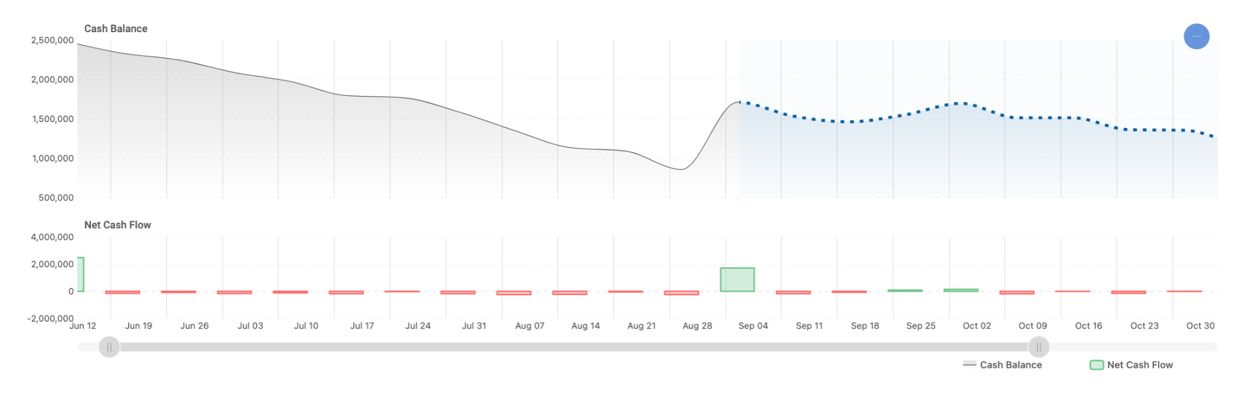
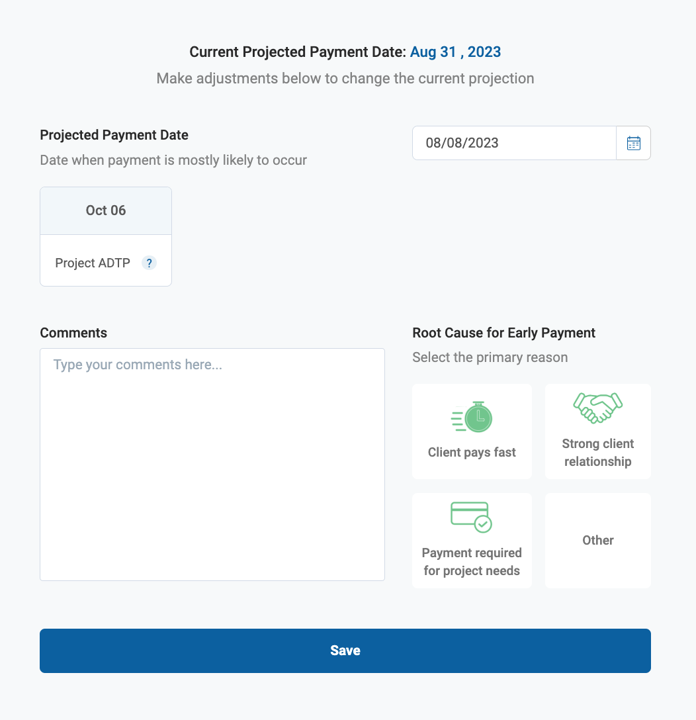
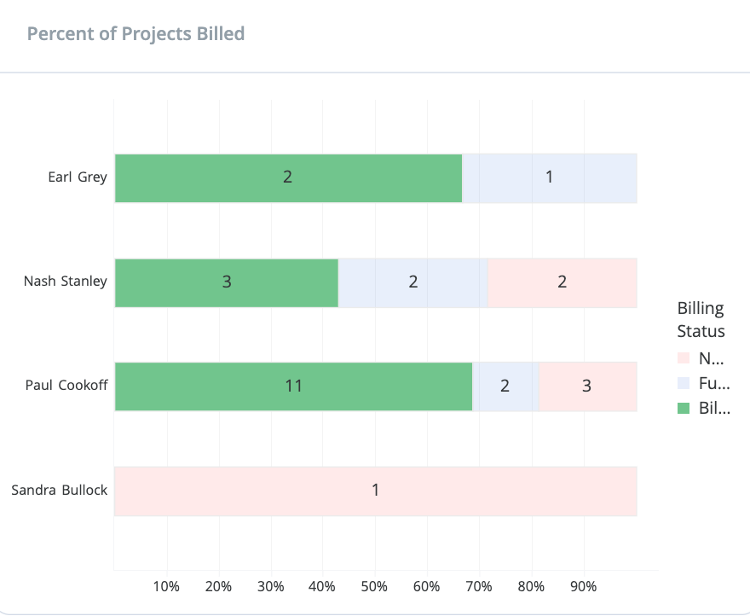
Protect Cash Flow
1
1
13-week view
to build a comprehensive 13-week cash flow forecast in seconds
Track invoices
2
3
2
3
to bill confidently, accurately, and collaboratively
3
Get paid faster
with less time and effort
Notes:
Talking Points:
ProNovos can help you safeguard cash flow by simplifying the cash flow forecast, enhancing billing processes, and optimizing accounts receivable collections for better financial management.
ProNovos does this by:
Cash Flow Forecasting
Simplify forecasting to identify potential cash shortages and mitigate risks.
Monitor your line of credit usage and anticipate drawdown needs.
Track cash inflows and outflows, including Accounts Receivable, Accounts Payable, and payroll expenses.
Customize the tool to align with your business's unique income and expense sources.
Monitoring Billings & Managing Invoicing
Ensure project teams have the necessary information for accurate project billing.
Track billing progress, percentage billed, and confirmations.
Monitor "Days to Pay" for payment insights and dive into cash received and outstanding amounts.
Accounts Receivable Collections Feature
Expedite invoice delivery to clients
Enhance payment predictability through automation
Automate invoice email notifications and follow-ups
Monitor and analyze Accounts Receivable outstanding and total retention
Script:
Let’s talk about something every construction professional cares deeply about: cash flow. It's the lifeblood of your company, and with ProNovos, you can take control and ensure a healthy financial outlook. Here's how ProNovos makes it happen:
Cash Flow Forecasting:
Let’s discuss cash flow forecasting. ProNovos simplifies this process, making it a breeze to identify potential cash shortages and mitigate risks. You can closely monitor your line of credit usage and anticipate when you might need to draw funds. It doesn't stop there; you can track every dollar coming in and going out, including Accounts Receivable, Accounts Payable, and payroll expenses. The best part? You can customize the tool to fit your business's unique income and expense sources, giving you tailored insights into your cash flow.
Monitoring Billings & Managing Invoicing:
Billing processes can be a headache, but ProNovos is here to make it smoother. With ProNovos, you ensure that your project teams have all the information they need for accurate project billing. You can easily track billing progress, see the percentage billed, and get confirmations in real time. Plus, you can closely watch "Days to Pay," providing valuable insights into when you can expect payments. And if you want to dive deeper, you can monitor cash received and outstanding amounts, giving you complete control over your invoicing.
Accounts Receivable Collections Feature:
Last, let's talk about getting those payments in the door. ProNovos offers an Accounts Receivable Collections report that streamlines the process. You better monitor and expedite invoice delivery to your clients, ensuring they receive them promptly. Payment predictability gets a boost through automation, making it easier to plan your finances. No more chasing down clients; ProNovos can automate invoice email notifications and follow-ups. And for those who love data, you can monitor and analyze your Accounts Receivable outstanding and total retention, ensuring you're on top of your collections game.
Let’s move on to how ProNovos can help your project managers and leadership team.

Slide 4

Take Control of Your Financial Success
From the field to the office, keep your team informed
1
FOR PROJECT MANAGERS
Turn Your Data Into Actionable Insights
Project financial KPIs
Insight into profitability & risks
Improve profit and cash flow
2
FOR THE OFFICE
Make Better Business Decisions
Better financial forecasts
Greater visibility into financial metrics
Eliminate manual reporting tasks
Notes:
Talking Points:
ProNovos empowers project teams and office leadership with comprehensive financial control and insights, fostering efficient decision-making and financial success.
Benefits for Project Managers/Team
Provide dynamic financial insights into critical KPIs for project budget, costs, billings, labor, and change orders
Leverage business intelligence for advanced project forecasting, enhancing profitability and risk assessment
Empower project managers with actionable insights to improve profits and cash flow
Benefits for the Office & Executives
Enhance the flexibility and accuracy of financial forecasts
Proactive visibility into essential financial reports and metrics
Analyze the total outstanding invoices due, retention, and who needs to pay what
See your top revenue sources by clients, sales, and change orders
Explore project profits by company, job status, PM, project type, size, geographic, and time period
View Change Orders across all projects, the number of statuses, and the impact on the overall financial outlook.
Save time and eliminate cumbersome reporting tasks like running search queries, compiling data from spreadsheets, and manual entry
Script:
Empowering Your Team and Leadership with ProNovos:
ProNovos empowers your project and leadership teams, giving you the tools for comprehensive financial control and insights. It's all about fostering efficient decision-making and achieving financial success.
Here's what ProNovos helps both teams:
Benefits for Project Managers/Team:
For Project Managers, ProNovos provides dynamic financial insights into those crucial Key Performance Indicators (KPIs) for your projects—budget, costs, billings, labor, and change orders. Imagine your project managers having business intelligence at their fingertips to take your project forecasting to the next level. You'll enhance profitability and assess risks with confidence. ProNovos helps PMs by providing actionable insights to improve profits and cash flow, making their job easier and more rewarding.
Benefits for the Office & Executives:
Let’s discuss how ProNovos can help executive leaders. It enhances the flexibility and accuracy of your financial forecasts, allowing you to plan with precision. You gain proactive visibility into essential financial reports and metrics, so you're always in the know—no more surprises. You can analyze the total outstanding invoices due, retention amounts, and who needs to pay what. Plus, you'll see your top revenue sources by clients, sales, and change orders, helping you steer the ship in the right direction. Dive deep into project profits by various criteria, from company and job status to Project Manager, project type, size, geographic location, and time period. And let's not forget about those pesky change orders; ProNovos enables you to view them across all projects, tracks their statuses, and shows you their impact on your overall financial outlook. Say goodbye to time-consuming reporting tasks like running search queries, compiling data from spreadsheets, and manual data entry. ProNovos saves you time and eliminates those headaches.
Whether you're a Project Manager looking for dynamic insights or an executive seeking proactive visibility, ProNovos will help you work smarter, not harder. Let’s look at a real-world example.

Slide 5



Atlas Excavating
Automation of KPIs and the WIP report has lead to greater efficiency and focus on higher value tasks
Immediate insight into projects billing has improved their cash position by $1,000,000 in the first 45 days
Access to live data and ease of understanding it has increased collaboration between office and field by giving everyone a quick glance at projects’ financial health
CLIENT SUCCESS
By utilizing ProNovos to automate financial data processes, Atlas Excavating has achieved increased efficiency and promptly gained clearer insights into their profits.
You want non-financial people to be able to consume and use data. I’ve got super-smart, younger PMs who just don’t have 25 or 30 years of experience in cash-management or other parts of the business. ProNovos helps them understand where they’re at on their projects—and they can take that understanding into their day-to-day responsibilities and negotiations.
— Casey Dillon, CEO & President
Notes:
Talking Points:
Atlas is a heavy civil contractor specializing in pipe and dirt, based in West Lafayette, Indiana, with a payroll of about 150 people and annual revenues of approximately $60 million.
They have been utilizing ProNovos since early 2022 and use Foundation Software
Atlas Excavating automated its financial data workflows into the pre-built dashboards in ProNovos’ cloud-based Analytics Marketplace.
The goal was to bolster profits by making better use of the company’s existing construction data
The next step is to schedule a meeting with ProNovos to see it live, discuss challenges, and have a more in-depth conversation.
Script:
Atlas Excavating is a heavy civil contractor specializing in pipe and dirt work. They're based in the heart of West Lafayette, Indiana, with a dedicated team of around 150 people. Atlas is a dynamic player in the industry, with annual revenues of approximately $60 million. In early 2022, Atlas started utilizing ProNovos to automate their financial data workflows using pre-built dashboards. This helped them to boost profits by making the best possible use of their existing construction data.
I would love for you to see this in action. Would you like to schedule a time to see it live?

